Slide 1
Penalized Models and the California Teachers Study
Eugene Nguyen
PM 606
Summer 2022

Slide 2
Goals
Develop a machine learning model capable of predicting mortality
Compare 3 different classification models
Utilize demographics, physical activity measures, diet measures, and primary diagnosis codes as inputs

Slide 3
Contents
Descriptive statistics
Methodology
Modeling
Results

Slide 4
Overall Descriptive Statistics
Total Observations = 154,315
Total Unique Individuals = 48,324
18,474 (38.2%) of the total unique individuals have passed away
Deceased | N (%)
Yes | 18474 (38.2%)
No | 29850 (61.8%)

Slide 5
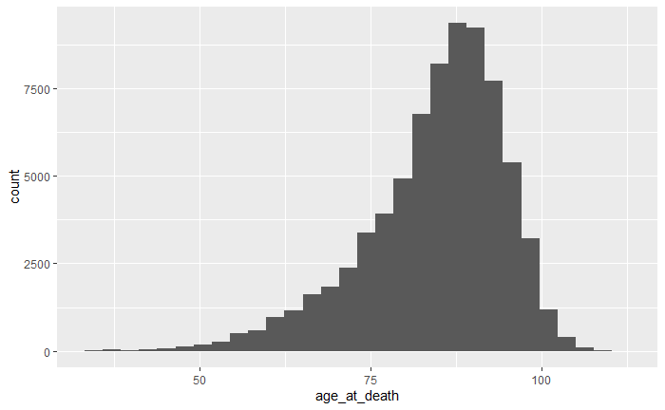
Age at Death
Minimum | 25% | 50% | Mean | 75% | Max
33.78 | 79.13 | 86.29 | 84.42 | 91.57 | 110.83

Slide 6
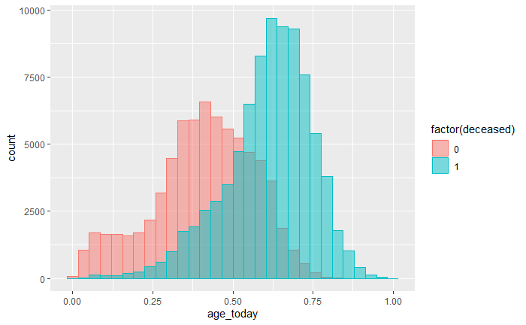
Age Today vs. Mortality
Minimum | 25% | 50% | Mean | 75% | Max
49.06 | 74.40 | 84.26 | 83.95 | 94.80 | 123.50

Slide 7
Contents
Descriptives
Methodology
Modeling
Results

Slide 8
Methodology
Compare 3 regularized classification models
Elastic Net
Lasso
Ridge
Note: Neural Networks and Random Forests were also explored, but the training time took too long (24-48 hours), therefore penalized models were chosen for balance of robustness and timeliness.

Slide 9
Inputs
Demographics
Age, urbanization, residence status, adopted, twin, birthplace, race/ethnicity
Clinical Factors
Number of admissions, total charges, primary ICD9 codes, primary ICD10 codes
Physical Activity
Hours of exercise per week, hours standing/walking per day at work, hours sitting, hours sleeping
Diet
Plant based, high protein/fat, high carb, ethnic diet, salad/wine, multivitamin, frequency of fat/oil in cooking

Slide 10
Data Handling
Data Clean
Converted all factors to dummy variables
Min/Max normalization of all continuous variables
Clean ICD codes to bucket into parent categories
Missing integer columns were filled with 0
Missing numeric columns were filled with the mean
Dummy variables with sparse positive classes were dropped (anything below 0.5%)
Data Split
Data split into a 70%/30% training and testing sets
Cross validation applied to the training set to tune lambda
The best parameters for each model will be tested against the final 30% set

Slide 11
Contents
Descriptives
Methodology
Modeling
Results

Slide 12
Models
Lasso
Can penalize coefficients to 0
Great when models contain a lot of useless variables
Ridge
Will shrink coefficients, but not remove
Great when models contain a lot of useful variables
Elastic Net
Combination of lasso and ridge

Slide 13
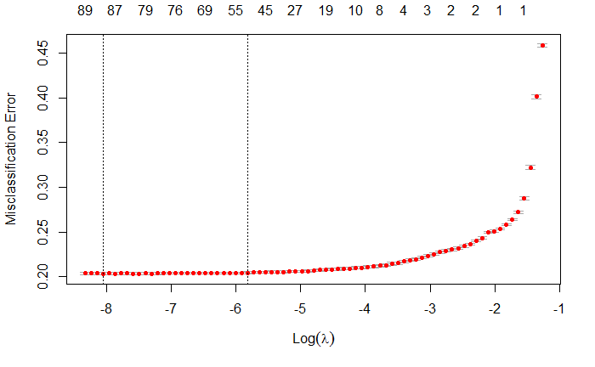
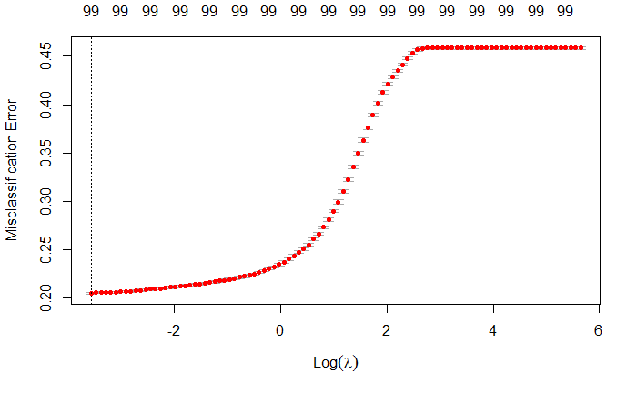
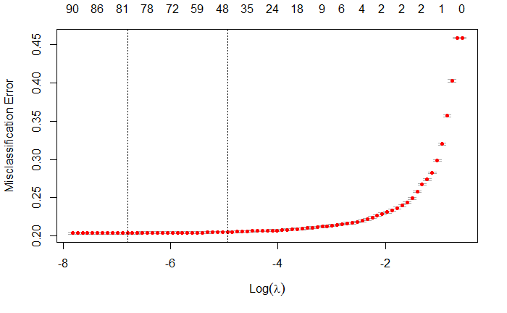
Cross Validation
10-fold cross validation was used for each model (lasso, ridge, elastic net)
The minimum lambda was extracted from each cross validation model and used on the testing set
Lasso
Ridge
Elastic Net

Slide 14
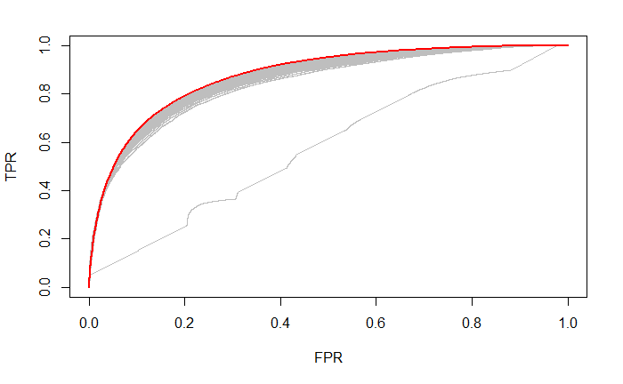
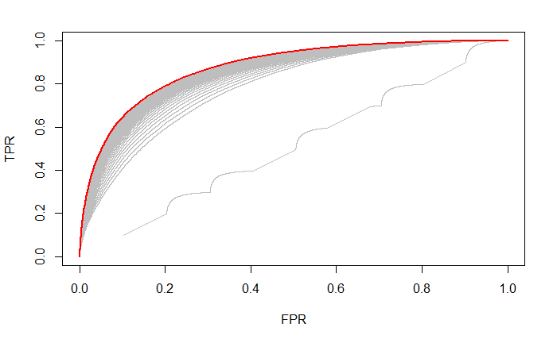

ROC Curves
ROC Curves were generated to visualize the cross validated models
The red curve depicts the best model with the highest AUC values
Lasso
Ridge
Elastic Net

Slide 15
Variable Importance – Top 10
Variable | Overall
Age Today | 8.1
Number of Admissions | 5.6
Musculoskeletal System Disease (ICD10) | 1.8
Total Charges | 1.1
Neoplasms (ICD9) | 0.87
Age at Baseline | 0.81
Musculoskeletal System Disease (ICD9) | 0.78
Injury/Poisoning (ICD10) | 0.77
Respiratory System Diseases (ICD9) | 0.77
Infectious Parasitic Diseases (ICD9) | 0.75

Slide 16
Contents
Descriptives
Methodology
Modeling
Results

Slide 17
Cross Validation Results – Training Data
Model | Minimum Lambda | AUC | Misclassification Error | Accuracy
Lasso | 0.00186 | 0.877195 | 0.2022681 | 0.7939
Ridge | 0.0282 | 0.877015 | 0.2036937 | 0.7934
Elastic Net | 0.00339 | 0.877243 | 0.2024193 | 0.7934
Lambda – Regularization parameter
AUC (Area Under the Curve) – Measure of the ability of a classifier to distinguish between classes; used as a summary of the ROC curve
Misclassification Error – Percentage of observations that were incorrectly predicted
Accuracy – Percentage of observations that were correctly predicted

Slide 18
Validation Results
Model | Accuracy | 95% CI | Sensitivity | Specificity | PPV | NPV
Lasso | 0.7977 | 0.794 – 0.801 | 0.752 | 0.837 | 0.798 | 0.798
Ridge | 0.7963 | 0.793 – 0.800 | 0.745 | 0.840 | 0.800 | 0.794
Elastic Net | 0.7976 | 0.794 – 0.801 | 0.751 | 0.837 | 0.798 | 0.797
Sensitivity –Percentage of true positives. Proportion of observations that tested positive and are positive of all the labels that are actually positive.
Specificity – Percentage of true negatives. Proportion of observations that tested negative and are negative of all the labels that actually are negative.
Positive Predictive Value (PPV) – Also known as precision. If the test result is positive, how well does that predict an actual presence of disease?
Negative Predictive Value (NPV) – Probability that observations with a negative predicted result truly should be negative.

